Slide 1

29/03/2024
ASSESSMENT -1

Slide 2
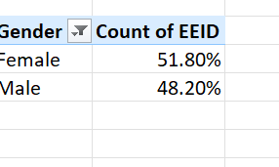
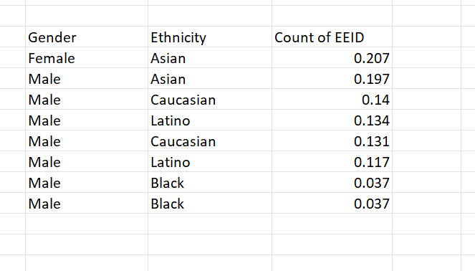
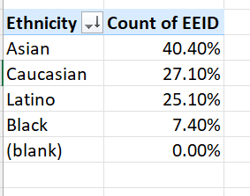
1.GENDER AND ETHNICITY

Slide 3
#INFERENCE
Gender- The percent of female employee is higher than male employees.
Ethnicity- The percent of employees are higher in Asian Ethnicity when Ethnicity is under consideration
Considering both, the Asian Females are higher in Number.

Slide 4
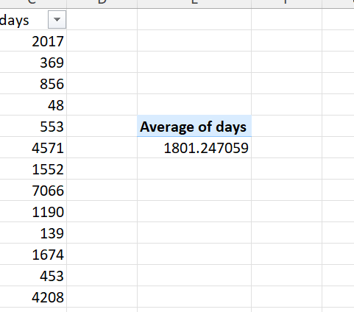
2.Average number of days people stay before exiting the company
The people that has exited the company is 1000 employees and the average days that they stayed in the company is approximately 1800 days.

Slide 5
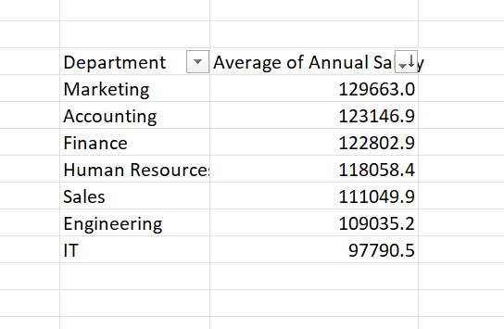
3. Significant difference in average salaries

Slide 6
#Inference
The highest average salary received is from marketing department(120 employees)
The lowest average salary is from IT department as it has the highest number of employees(241)

Slide 7
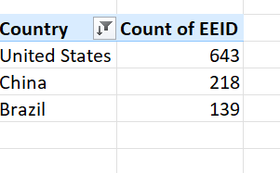
4.Country with most employees
The country “United States” have the most number of employees with the count of 643

Slide 8
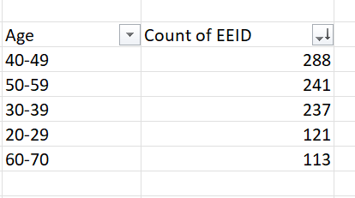
5.Common age range among employees
The most common Age Group among the Employee dataset is Age 40 to 49.

Slide 9

6.Average bonus given to employees
The Bonus range starts from 0% to 40% and the average range of bonus% fro the 1000 employees is 8.87%.

Slide 10
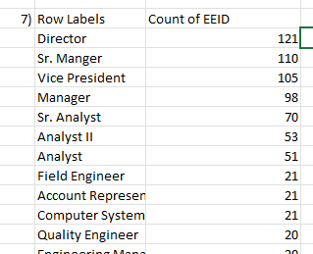
7.Job title occurring most frequently
The most occurring job title is Director with a count of 121 employees out of 1000 employees.

Slide 11
8.Primary reasons cited for employee exit
Growth development is not there
No increase in pay for years of service
Work-Life balance is not being managed.
Learning new things is not that much available in work.

Slide 12
9.Departments in due of Ethnicity
Ethnicity considered in every department , employees where ethnicity ,highest is Asian and lowest is Black.
The department IT has 241- large number of employees and the Accounting has 120- the lowest number of employees

Slide 13
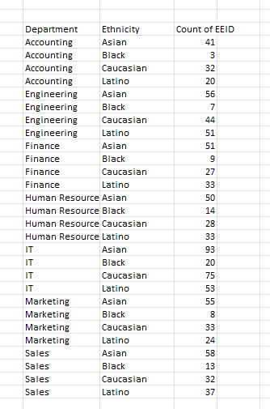

Slide 14
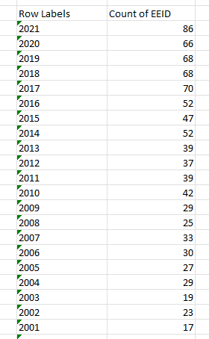
10.Increase or Decrease in hiring Employee
There has been both increase and decrease over the past few years but with a slight difference in count considering between 2015 and 2021.

Slide 15

THANK YOU !

